Slide 1
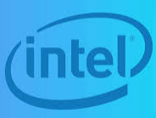
1.1 Brief History of Intel Processors
Intel, in full Intel Corporation, American manufacturer of semiconductor computer circuits.
It is headquartered in Santa Clara, California. The company’s name comes from “integrated electronics.”
Intel was founded in July 1968 by American engineers :Gordon Moore &Robert Noyce

Slide 2
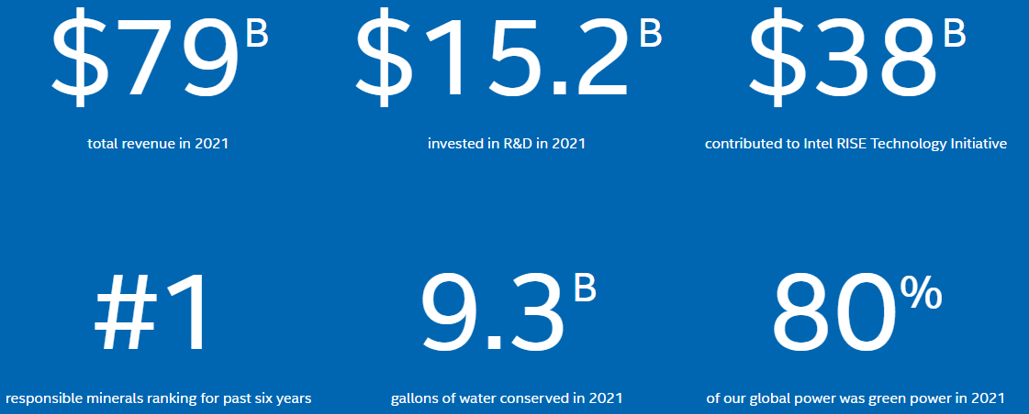
Intel in 2021

Slide 3
List of companies designing CPU
most of these companies only make designs, and do not manufacture their own designs.
Top x86 CPU manufacturers:
AMD
Intel
List of CPU manufacturers (most of the companies sell ARM-based CPUs,):
Arm Ltd. (sells designs only)
Apple Inc. (ARM-based CPUs)
Broadcom Inc. (ARM-based, e.g. for Raspberry Pi)
Fujitsu (its ARM-based CPU used in top supercomputer, still also sells its SPARC-based servers)
Hitachi (its own designs and ARM)
Hygon (x86-based)
HiSilicon (acquired by Huawei), stopped making its ARM-based design
IBM (now only designs two architectures)
Ingenic Semiconductor (MIPS-based)
Marvell (its ThunderX3 ARM-based)
MCST (its own designs and SPARC)
MediaTek (ARM chips, and MIPS chips)[2]
Nvidia (sells ARM-based, and unsuccessfully attempted to buy the ARM company)
Qualcomm (ARM-based)
Rockchip (ARM-based)
Amlogic (ARM-based)
Allwinner (ARM-based)
Samsung (ARM-based)
SiFive (RISC-V-based, e.g. HiFive Unleashed)
Texas Instruments (its own designs and ARM)
Via (formerly Centaur Technology division), its own x86-based design
Wave Computing (previously MIPS Technologies), licenses MIPS CPU design
Zhaoxin (its own x86 design based on Via's)

Slide 4
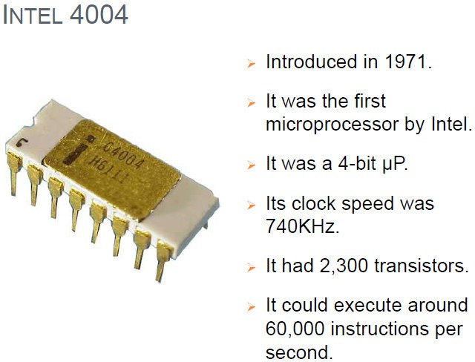

Slide 5
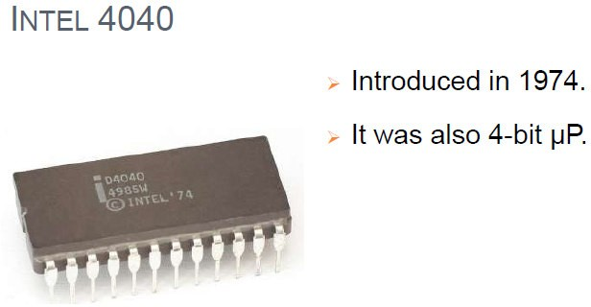

Slide 6
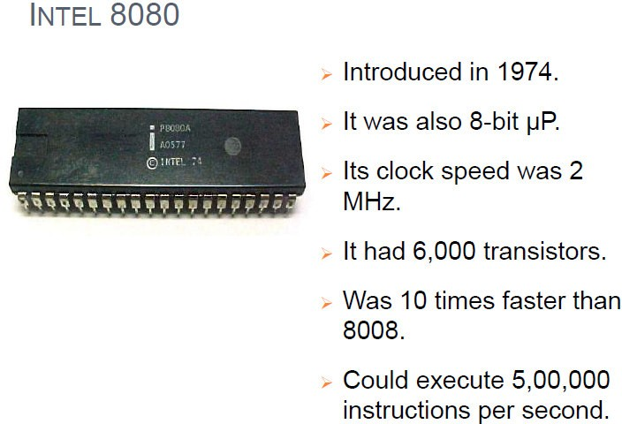

Slide 7
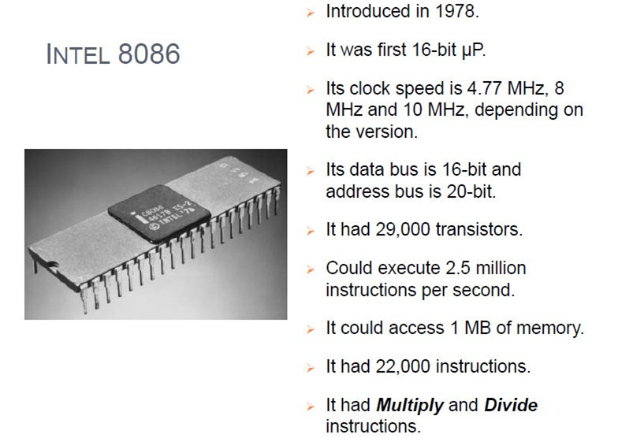

Slide 8
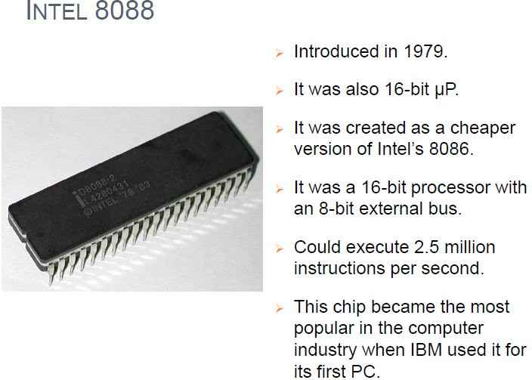

Slide 9
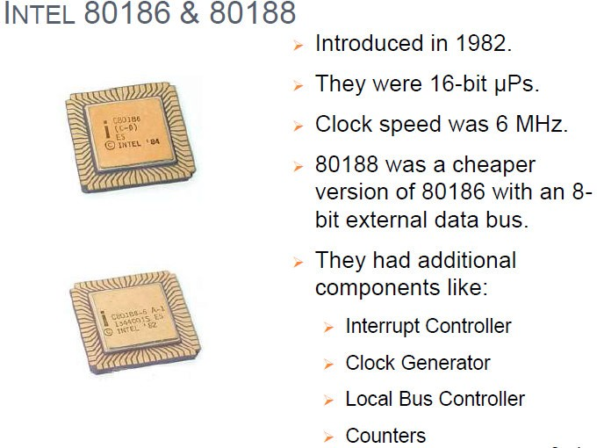

Slide 10
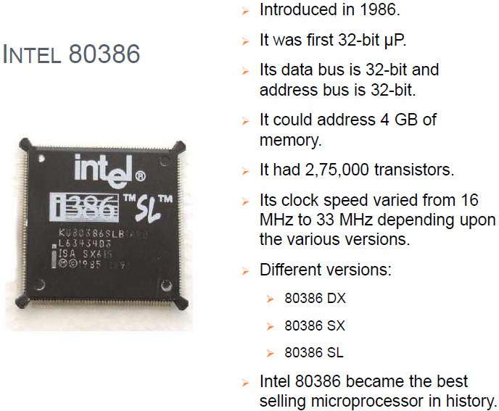

Slide 11
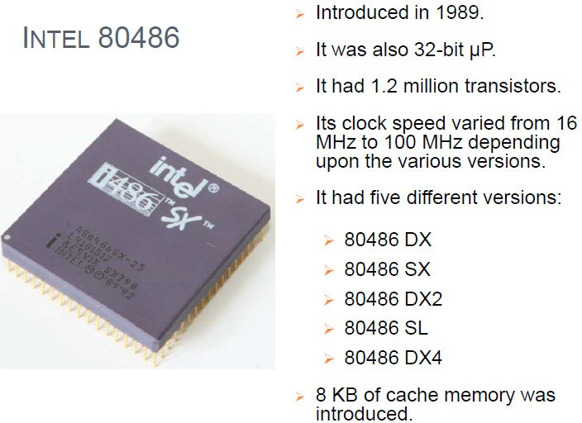

Slide 12
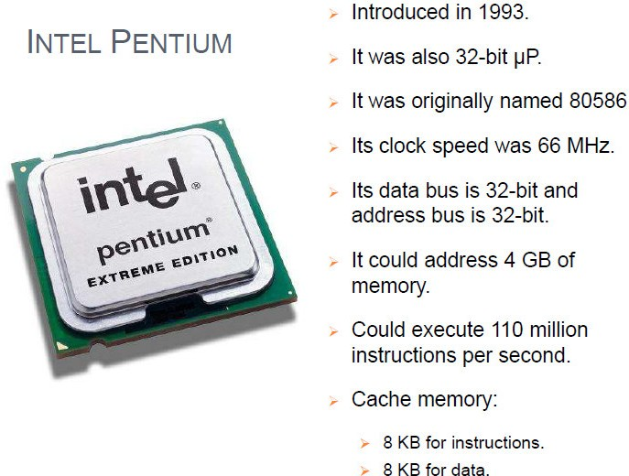

Slide 13
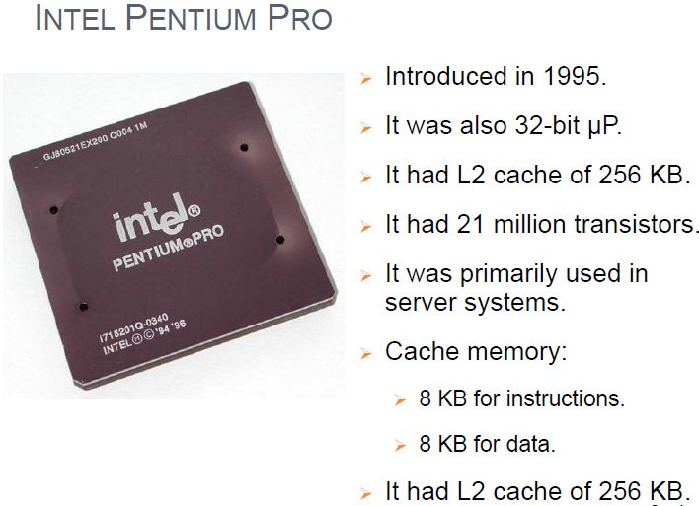

Slide 14
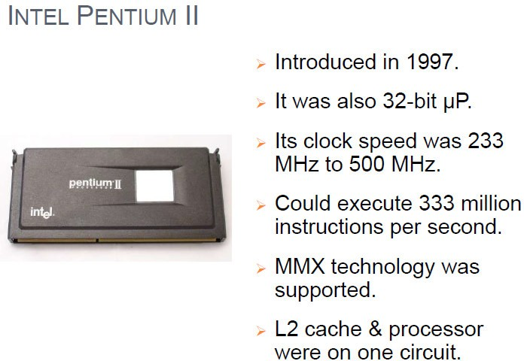

Slide 15
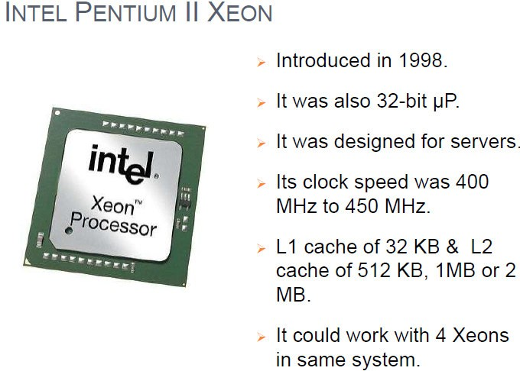

Slide 16
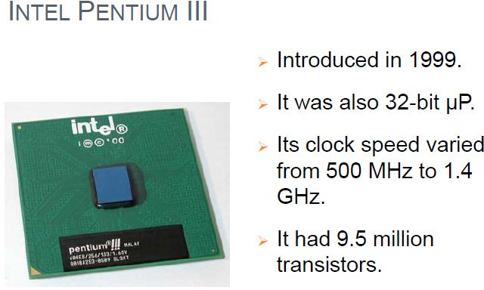

Slide 17
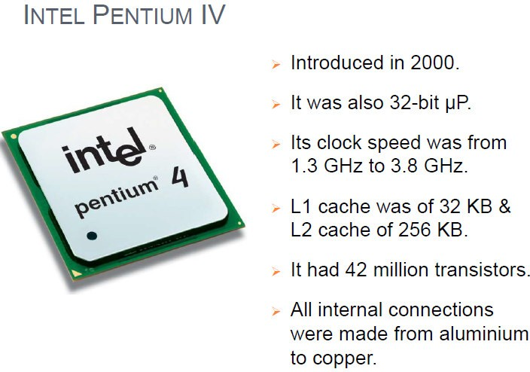

Slide 18
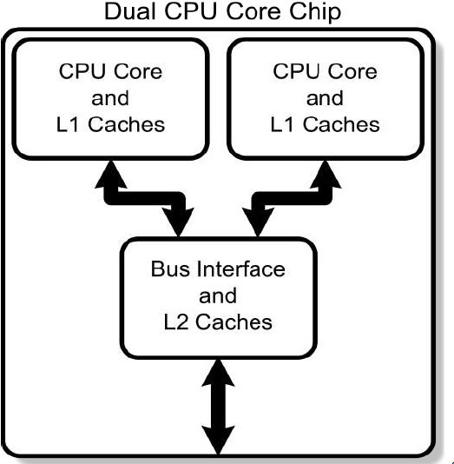
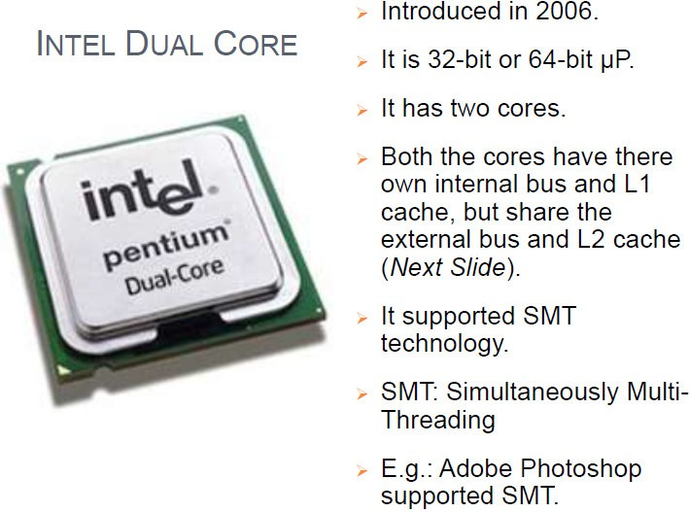

Slide 19
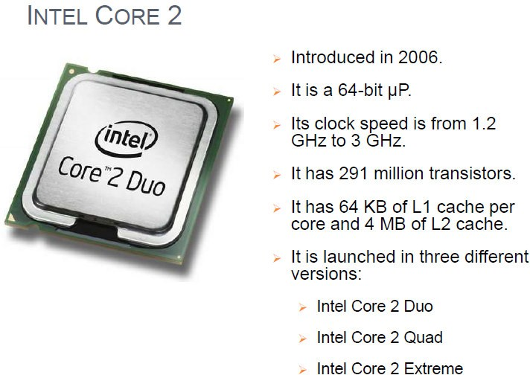

Slide 20
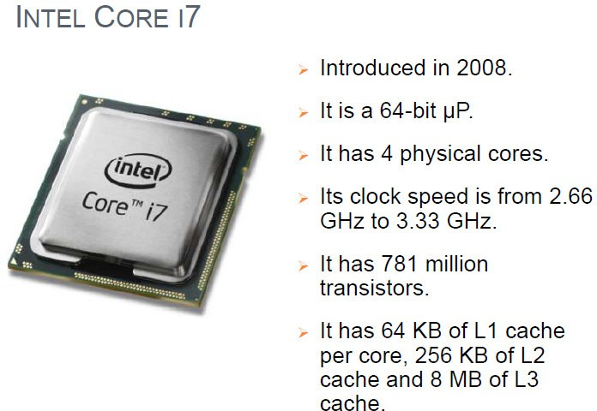

Slide 21
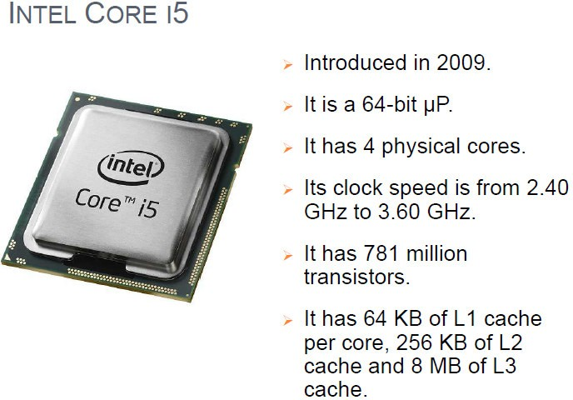

Slide 22
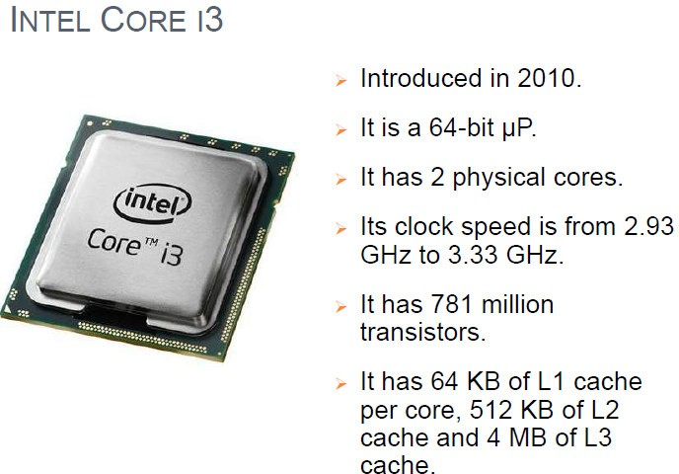

Slide 23
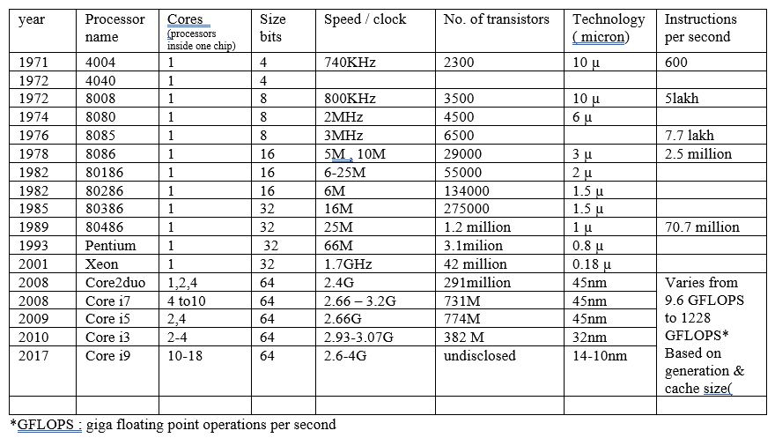

Slide 24
Intel has three brands
Intel® processor : is an economical product line created for price-conscious consumers.
Intel® Core™ processors have faster performance and additional features not available in Intel® Processor models.
Intel® Xeon® processors offer a higher level of performance for servers and workstations
Intel® Core™ brand has 4 brand modifiers ( i.e. processors )
i3
i5
i7
i9

Slide 25
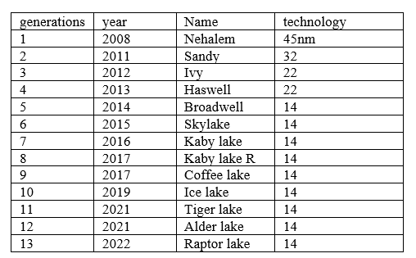
Each of the above core processors ( brand modifiers ) have various generations (1 to 13)
The main difference between different generations is the architecture. They also got better RAM support, cache support, and overclocking capabilities

Slide 26
13th generation Core Desktop (codenamed "Raptor Lake”)
Processor family | Cores |  |  | Clock rate (GHz) |  |  |  |  |  | Integrated graphics |  |  | Cache |  | watts |  | Price (USD)
 |  |  |  | Base |  | Turbo 2.0 |  | Max. Turbo | Turbo max. 3.0 | GPU | Clock rate, max. | EUs | L2 cache | Smart cache | Base | Turbo
 | P | E | Threads | P | E | P | E
Core i9 | 8 | 16 | 32 | 3.0 | 2.2 | 5.5 | 4.3 | 5.8 | 5.7 | UHD 770 | 1.65 GHz | 32 | 32 MB | 36 MB | 125 | 253 | $589
Core i7 | 8 | 8 | 24 | 3.4 | 2.5 | 5.3 | 4.2 | 5.4 |  | UHD 770 | 1.6 GHz | 32 | 24 MB | 30 MB | 125 | 253 | $409
Core i5 | 6 | 8 | 20 | 3.5 | 2.6 | 5.1 | 3.9 | 5.1 | — | UHD 770 | 1.5 GHz | 32 | 20 MB | 24 MB | 125 | 181 | $319

